Slide 1



SMART INDIA HACKATHON 2025
TITLE PAGE
Problem Statement ID – SIH25151
Problem Statement Title- Identification of Infrastructure, Amenities, and Service Gaps in SC-Majority Villages for Adarsh Gram Declaration
Theme - Smart Automation
PS Category- Software
Team ID - 94062
Team Name - Coding Gurus VESIT

Slide 2

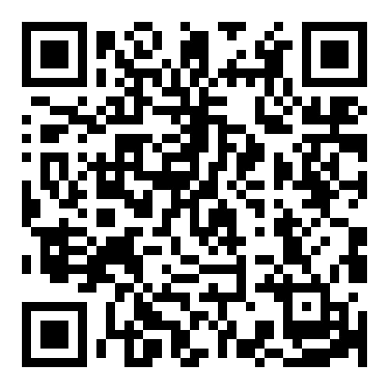
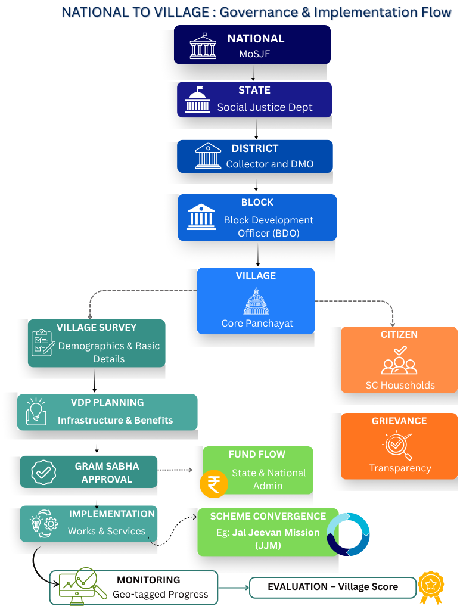
GRAMLINK ( ग्राम-Link)
हर गाँव, हर घर – आदर्श बनेगा नगर
Click Here
Proposed Solution: GramLink Web/App ( ग्राम-Link )
GramLink Web/App is a multilingual platform that uses AI-powered planning, blockchain-secured monitoring and automated reporting to transform SC-majority villages into Adarsh Grams. It enables gap detection, fund tracking, predictive monitoring, and citizen engagement for transparent and efficient rural development.
**Case Study
Site: Rahatoli – Jambhilghar, Thane, Maharashtra
**Referred from PMAGY May 2023 Guidelines
Gap Analysis: AI detects missing infrastructure and service gaps in education, healthcare, sanitation, and connectivity.
Smart VDP: Auto-drafts Village Development Plans with scheme-linked funding suggestions.
Fund Tracker: Monitors releases, utilization, and progress with AI-powered delay alerts.
Predictive Alerts: Forecasts project completion timelines and flags bottlenecks early.
Blockchain Security: Ensures tamper-proof records, transparent fund flows, and secure project data.
Auto Reports: Generates district, state, and national reports with charts and AI-driven narrative insights for decision-making.
Citizen Portal: Transparent access to projects, decisions, and feedback.
Role-Based Dashboards: Tailored views for National, State, District, Block, and Village officers to track performance and take action.
Innovation and Uniqueness:
Village score Leaderboard
GIS and Geo-tagging
Offline-sync for rural areas
Smart Survey App
Blockchain-secured Funds
AI-Insights and Analytics
Citizen Feedback
Auto VDP Draft
Auto-generated Reports
Extensive Dashboards
Project Implementation : Implementation-Video | Website | Mobile-App (60% Completed and Tested)
FIGURE NO: 01

Slide 3
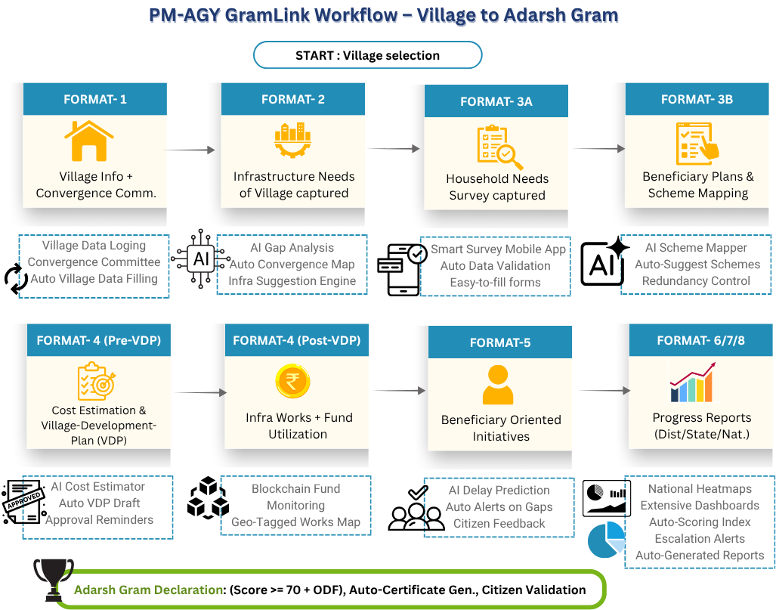
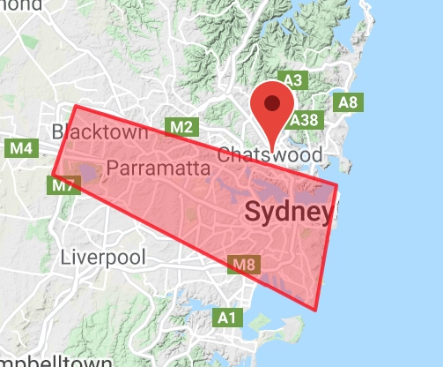





TECHNICAL APPROACH
TECHNICAL APPROACH
TECH STACK
Frontend: Next.js, Tailwind CSS , Shadcn
● Backend: Flask, Node.js
● Database, Hosting, Authentication: Firebase
● AI/ML Integration:Hugging face,langchain, n8n , Google ADK
● Geo-fencing: Leaflet
● Blockchain: Hyperledger Fabric
● Automated Reporting: D3.js / Chart.js
● MFA and OTP Services: Firebase Authentication
Mobile App: Android and Flutter
FIGURE NO: 02

Slide 4
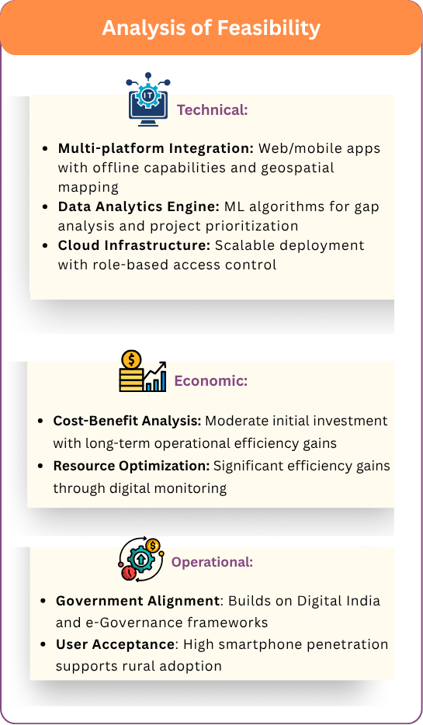
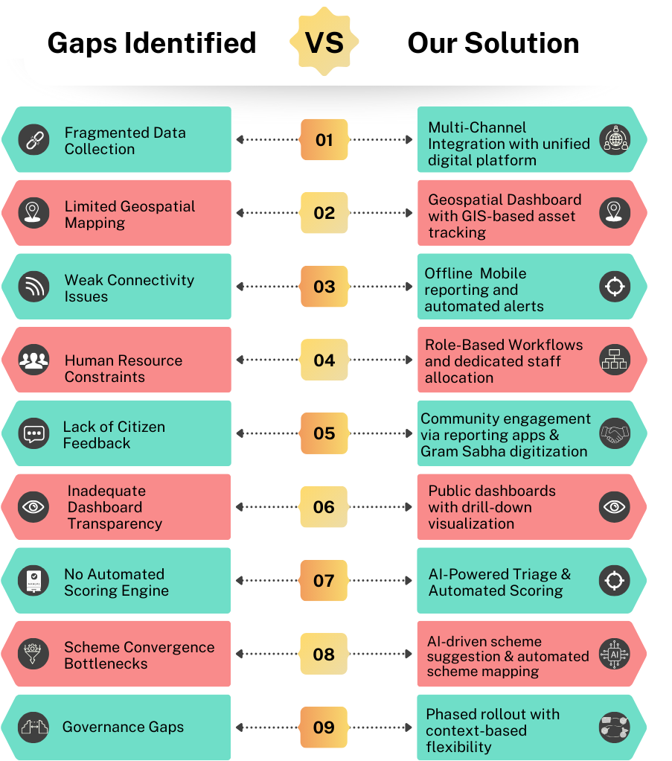
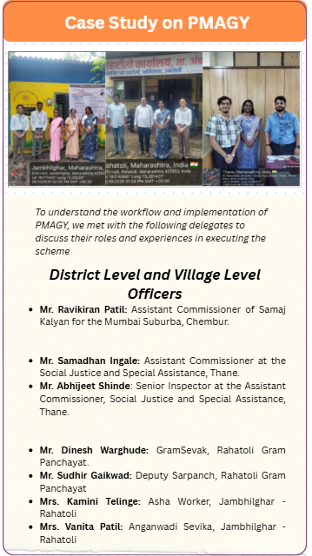
FEASIBILITY AND VIABILITY
Report
Report
Report

Slide 5
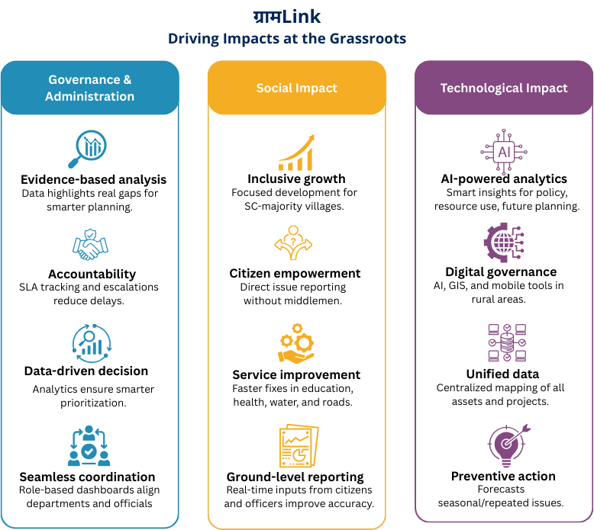
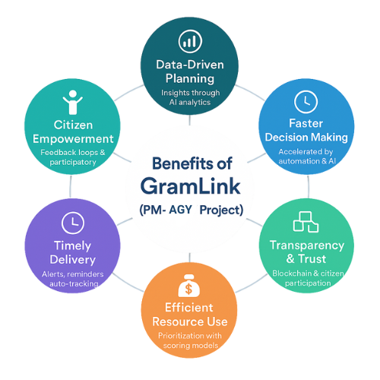
IMPACT AND BENEFITS

Slide 6
RESEARCH AND REFERENCES
References
[1] Ministry of Social Justice & Empowerment, Flow Diagram to Generate the Interim VDP. Available: https://pmagy.gov.in/Docs/Flow-Diagram-to-Generate-the-Interim-VDP.pdf
[2] Ministry of Social Justice & Empowerment, PMAGY Platform User Manual. Available: https://pmagy.gov.in/Docs/User_Manual_of_AGY.pdf
[3] Ministry of Social Justice & Empowerment, PMAGY Implementation PPT. Available: https://pmagy.gov.in/Docs/PPT_PMAGY_24102019.pdf
[4] Ministry of Social Justice & Empowerment, Flow Chart – PMAGY. Available: https://pmajay.dosje.gov.in/Flow-Chart
[5] Press Information Bureau, “Pradhan Mantri Anusuchit Jaati Abhuyday Yojana (PM-AJAY)”, Release ID: 1995258, 11 Jan. 2024. Available: https://www.pib.gov.in/PressReleaseIframePage.aspx?PRID=1995258 Press Information Bureau
[6] Ministry of Social Justice & Empowerment, PMAGY Eligibility Criteria. Available: https://pmagy.gov.in/Eligibility-Criteria
Research
[1] “Case Study Report on PMAGY Process at Samaj Kalyan Office, Chembur,” Google Docs. [Online]. Available: [Link] .
[2] “GramLink – Dr. Babasaheb Ambedkar Samajik Nyay Bhavan Report,” Google Docs. [Online]. Available: [Link].
[3] “Case Study Report on PMAGY Process at with Ground-level Workers, Rahatoli,” Google Docs. [Online]. Available:[Link].
[4] “GramLink – Extensive Details,” Google Docs. [Online]. Available: [Link] .
[5] “PPT Explanation – GramLink,” YouTube. [Online Video]. Available: https://www.youtube.com/watch?v=oG60d3G478g.
[6] “Implementation – GramLink,” YouTube. [Online Video]. Available: https://youtu.be/1KOcHaGgcFI.

